Slide 1

Recursion
Data Structures
Dr. Bouchaib Falah

Slide 2
Writing Repetitive Algorithms
In general, there are two approaches to writing repetitive algorithms:
using iteration (loops)
using recursion
☞ A repetitive function is defined as iterative when the definition involves only parameters and not the function itself.
☞ A repetitive function is defined as recursive when the definition involves the function itself (the function appears within the definition itself)
Note: Many older languages do not support recursion.

Slide 3
Example: Iterative Factorial
Iterative definition
1 if n = 0
factorial(n) =
n * (n-1) * (n-2) * …….. * 2 *1 if n > 0
Using this definition, write a program that prompts the user to enter a positive integer and executes its factorial.

Slide 4
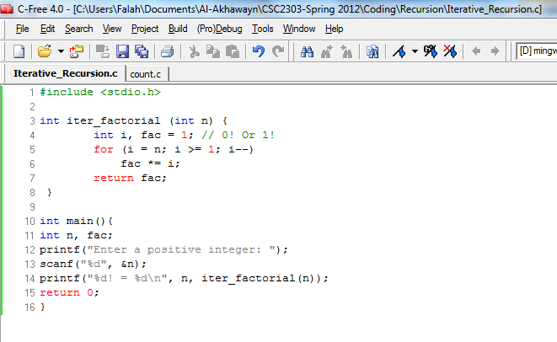
Solution: Iterative Factorial

Slide 5
Example: Recursive Factorial
Notice that
5! = 5 * 4 * 3 * 2 * 1
5! = 5 * 4!
4! = 4 * 3! ...
Recursive definition
1 if n = 0
factorial(n) =
n * factorial(n-1) if n > 0
The definition of factorial itself uses a factorial
Using the function name itself in the definition of the function makes it a recursive definition

Slide 6

Example: Recursive Factorial
Compute 5!

Slide 7
Example: Recursive Factorial
f(5)=5·f(4)

Slide 8
Example: Recursive Factorial
f(4)=4·f(3) | f(5)=5·f(4)

Slide 9
Example: Recursive Factorial
f(3)=3·f(2) | f(4)=4·f(3) | f(5)=5·f(4)

Slide 10
Example: Recursive Factorial
f(2)=2·f(1) | f(3)=3·f(2) | f(4)=4·f(3) | f(5)=5·f(4)

Slide 11
Example: Recursive Factorial
f(1)=1·f(0) | f(2)=2·f(1) | f(3)=3·f(2) | f(4)=4·f(3) | f(5)=5·f(4)

Slide 12
Example: Recursive Factorial
f(0)= 1→ | f(1)=1·f(0) | f(2)=2·f(1) | f(3)=3·f(2) | f(4)=4·f(3) | f(5)=5·f(4)

Slide 13
Example: Recursive Factorial
1·1= 1→ | f(2)=2·f(1) | f(3)=3·f(2) | f(4)=4·f(3) | f(5)=5·f(4)

Slide 14
Example: Recursive Factorial
2·1= 2→ | f(3)=3·f(2) | f(4)=4·f(3) | f(5)=5·f(4)

Slide 15
Example: Recursive Factorial
3·2= 6→ | f(4)=4·f(3) | f(5)=5·f(4)

Slide 16
Example: Recursive Factorial
4·6= 24→ | f(5)=5·f(4)

Slide 17
Example: Recursive Factorial
5·24= 120→

Slide 18
Example: Recursive Factorial
Return 5! = 120

Slide 19
Example: Recursive Factorial
Recursive definition
1 if n = 0
factorial(n) =
n * factorial(n-1) if n > 0
Using this Recursive definition of factorial function, write a program that prompts the user to enter a positive integer and executes its factorial.

Slide 20
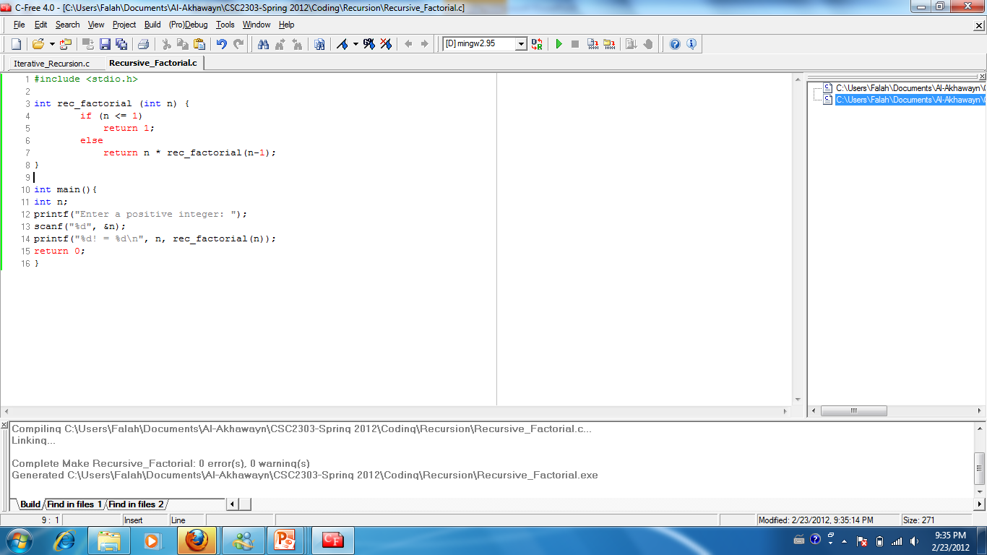
Solution: Recursive Factorial

Slide 21
Recursive Functions in General
Are functions that call themselves
If you were to examine all possible recursive functions, you would see that they all have two elements:
What can be solved immediately – the base case
E.g. for factorial this is the 0! Or 1! part, i.e. n <= 1
What cannot be solved immediately – the general case
A bit of work that can be done by the function, E.g. for factorial this is the ‘n * ’ part
Each call either solves one part of the problem or it reduces the size of the problem.

Slide 22
Rules for Designing a Recursive Function
 Each recursive function must have a Base Case.
Once the base case has been reached, the solution begins. We know one part of the answer and can return that part to the next statement
The Rules:
1. Determine the base case
2. Determine the general case.
3. Combine the base case and general case into a function.
NB: In some cases, the general case appears first than the base case!
Logic:
Each call must reduce the size of the problem and move it towards the base case.
The base case, when reached, must terminate without a call to the recursive function; that is, it must execute a return.

Slide 23
Example: Fibonacci numbers
Fibonacci numbers are a series of numbers in which each number is the sum of the previous two numbers:
0, 1, 1, 2, 3, 5, 8, 13, 21, 34 , …..
To start, the series, we need to know the first two numbers. AS you can see from the above series, they are zero and one.
Hence:
Base case: fib(0) = 0, fib(1) = 1;
general case: fib(n) = fib(n-1) + fib(n-2)

Slide 24
Fibonacci Numbers Implementation
Recursive definition
0 if n = 0
fib(n) = 1 if n = 1
fib(n-1) + fib(n-2) if n > 1
Using this Recursive definition of Fibonacci function, write a program that prompts the user to enter a positive integer and executes its Fibonacci numbers.

Slide 25
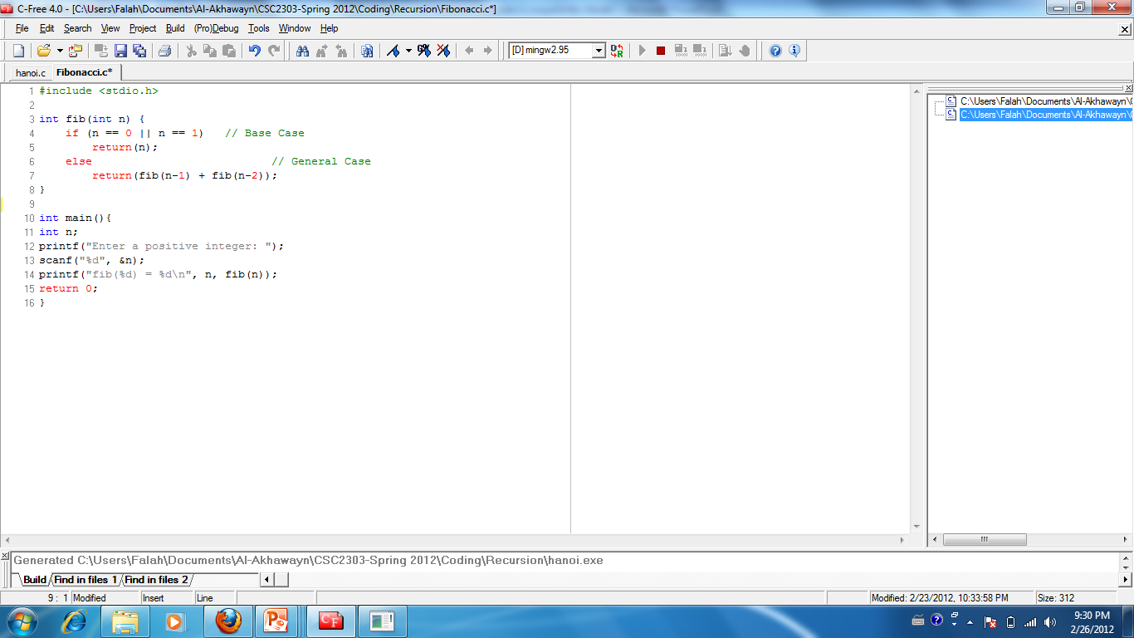
Solution: Fibonacci Numbers

Slide 26
Example: Towers of Hanoi
 Legend says that the world will come to its end when problem solved for 64 disks!!
A
B
C

Slide 27
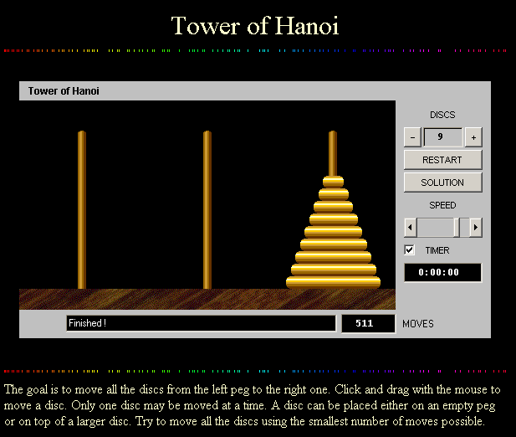
Towers of Hanoi on the Web
http://www.mazeworks.com/hanoi/
Solve it or watch the computer solve it

Slide 28
Stating the problem
Three pegs A, B, C
The puzzle begins with all disks placed in Peg A in such a manner that no disk is resting on a smaller one
All disks have to be moved in the same order to Peg C
At any time during the solution you can place disks on any of the three pegs with the following restrictions:
You can only move the topmost disk on any peg
At no time may a larger disk rest on a smaller one

Slide 29
Solving the problem
If we had a solution for (n-1) disks, it would seem obvious that we could solve the puzzle for n disks:
Solve the puzzle for (n-1) disks, then move the remaining disk to Peg C, then solve the puzzle again for (n-1) disks
Similarly, if we could solve the problem for (n-2) disks, the (n-1) case would be also simple
We can continue on this way until the trivial/base case where n = 1: Simply move disk from A to C
Let’s concretize the ‘Recursion’ above:
If n = 1, move the disk from A to C
Move n-1 disks from A to B using C as Auxiliary
Move the n disk from A to C
Move n-1 disks from B to C using A as auxiliary

Slide 30
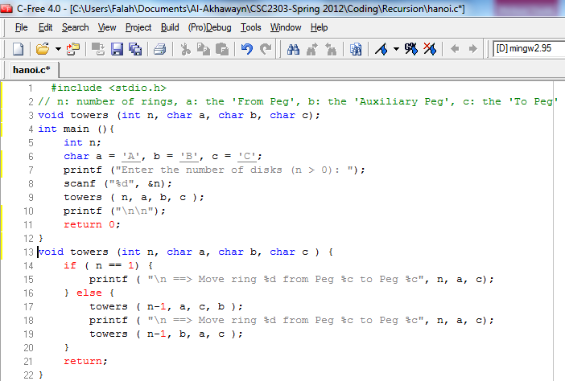
Towers of Hanoi: Code

Slide 31
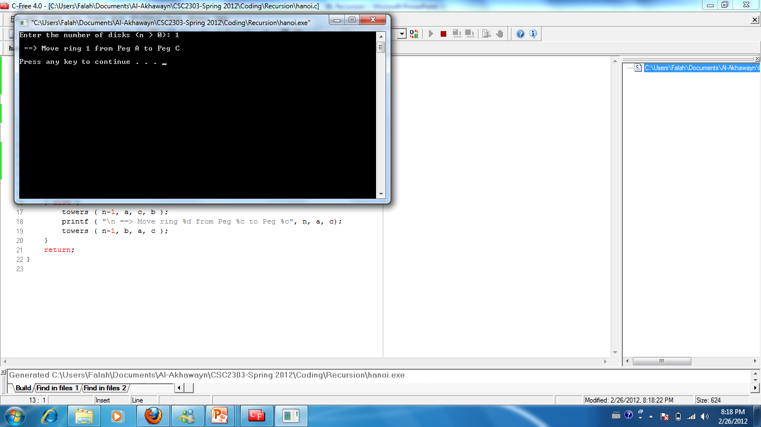
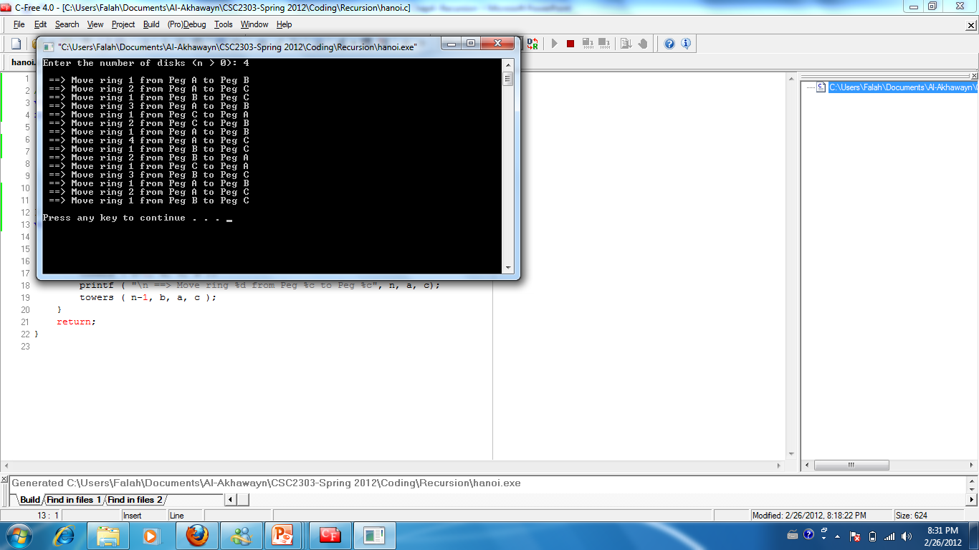
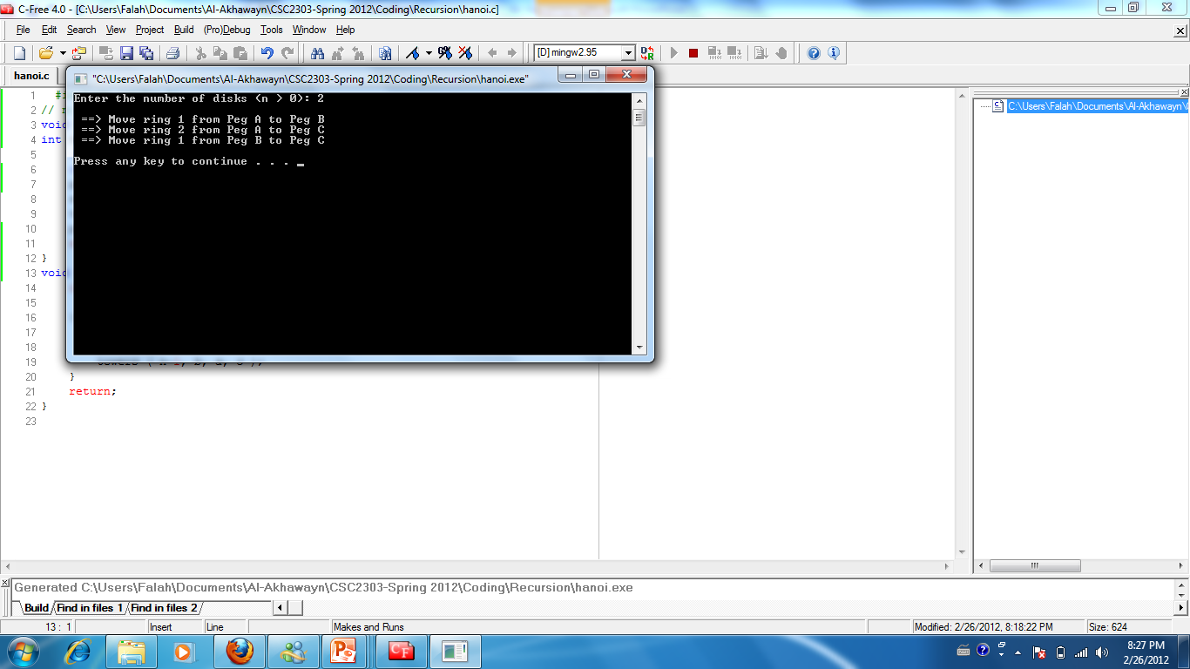
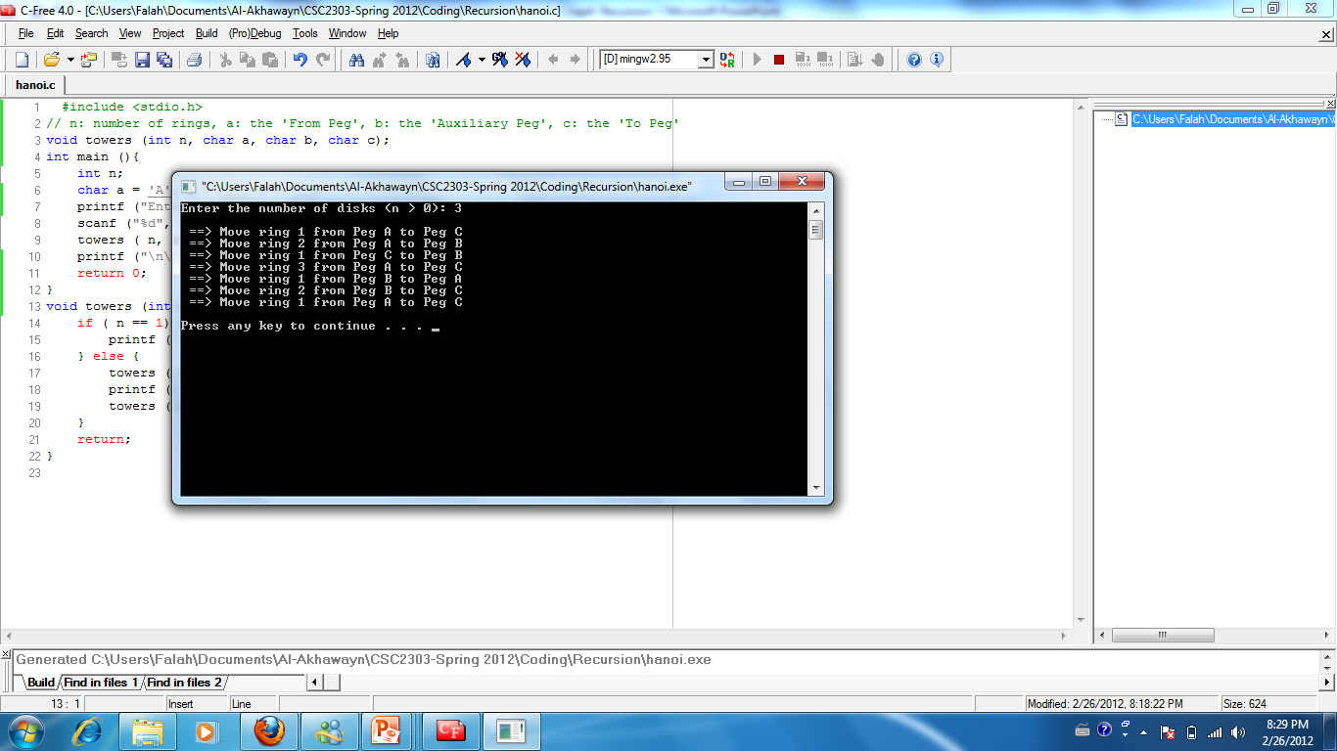
Towers of Hanoi: Execution

Slide 32
Use of Recursion
Once the technique is understood, the question most often asked is: “when to use it”?
By definition, all ‘Recursive’ functions have a corresponding ‘Iterative’ solution
 Recursive algorithms require more time
See next slide for an illustration of Time Complexity
 Recursive algorithm waste much space:
each recursive call requires the creation of an ‘Activation Record’ in the stack
each activation record contains the following:
parameters, local variables, return address, stack link
Hence, if the depth of recursion is large the required space may be much significant!

Slide 33
Time Complexity
How do you measure time? Time to move one ring : T(1)
T(1) = 1 = 2⁰ = 2¹ -1
T(2) = 2*T(1) + 1 = 2¹ + 1 = 2¹ + 2⁰ = 3 = 2² -1
T(3) = 2*T(2) + 1 = 2 * (2¹ + 2⁰) + 1 = 2² + 2¹ + 1 = 7 = 2³ -1
T(4) = 2*T(3) + 1 = 2 * (2² + 2¹ + 1) + 1 = 2³ + 2² + 2 + 1 = 15 = 2⁴ -1
T(5) = 2*T(4) + 1 = 2 * (2³ + 2² + 2 + 1 ) + 1 = 2⁴ + 2³ + 2² + 2 + 1 = 31 = 2⁵ -1 …
T(n) = 2T(n-1) + 1 = 2 * (2^{n-1} -1) + 1 = 2^{n} - 2 + 1 = 2^{n} -1
 T(n) = O(2^{n}) → “Exponential”, that is, the worst!
Recursive algorithms are known to be time consuming!
Conclusion:
Avoid recursion when the size of the problem (n) grows bigger
However, for many problems the recursive solution is more natural than the alternative non-recursive or iterative solution

Slide 34
Practices:
Write a recursive ‘int multiply(int, int)’ function
Write a recursive function ‘sum(int n)’ that calculates the sum of successive integers starting at 1 and ending at n
sum(n) = 1+2+…+n

